Slide 1



Intercultural Communication ICC

Slide 2
icc
The term first used by Edward T. Hall in 1959 and is simply defined as interpersonal communication between members of different cultures.
ICC can include
International
Interethnic
Interracial
Interregional

Slide 3
Importance
Globalization of markets
Technological advancements
Cultural connectivity
Intercultural workforce

Slide 4

FACTORS IN SUCCESSFUL CROSS- CULTURAL COMMUNICATION
How are behavior and expectations affected by cultural background?
What factors associated with (cross-cultural) transitions make adaptation to cultural differences difficult?

Slide 6
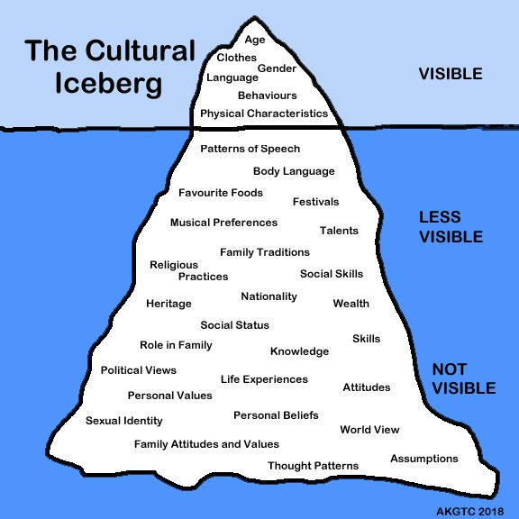

Slide 10
Potential problems in ICC
Avoidance of the unfamiliar
Uncertainty reduction Withdrawal
Stereotyping
Racism
Misuse of power
Culture shock
Ethnocentrism

Slide 11
Cultural shock
Honeymoon phase
Cultural shock phase
Recovery phase
Adjustment phase

Slide 13
Hofstede's Cultural Dimensions
Power Distance Index (high versus low).
Individualism Versus Collectivism.
Masculinity Versus Femininity.
Uncertainty Avoidance Index (high versus low).
Long- Versus Short-Term Orientation.
Indulgence Versus Restraint.

Slide 14
Activity
https://www.hofstede-insights.com/country-comparison

Slide 15
Ways to reduce Intercultural miscoummunication
Your comments
https://medium.com/waat-ltd/how-to-avoid-the-cultural-misunderstandings-that-can-impact-your-business-c4a70941c65a

